Slide 1
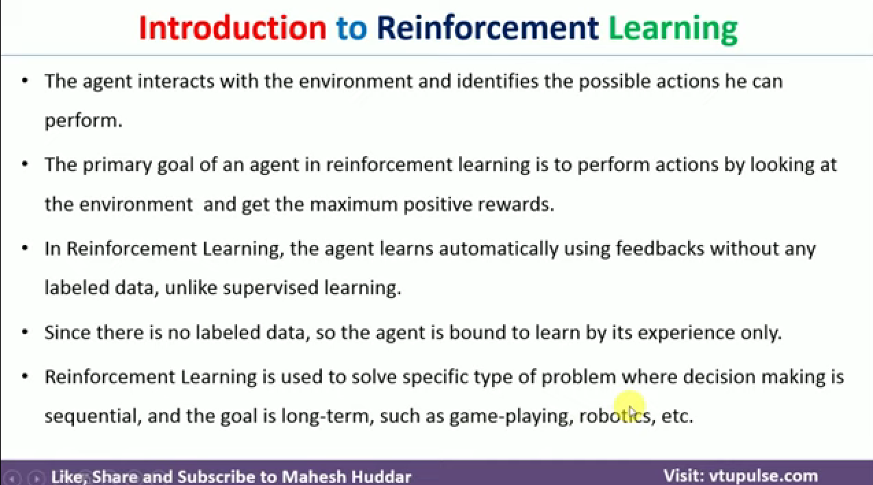

Slide 2
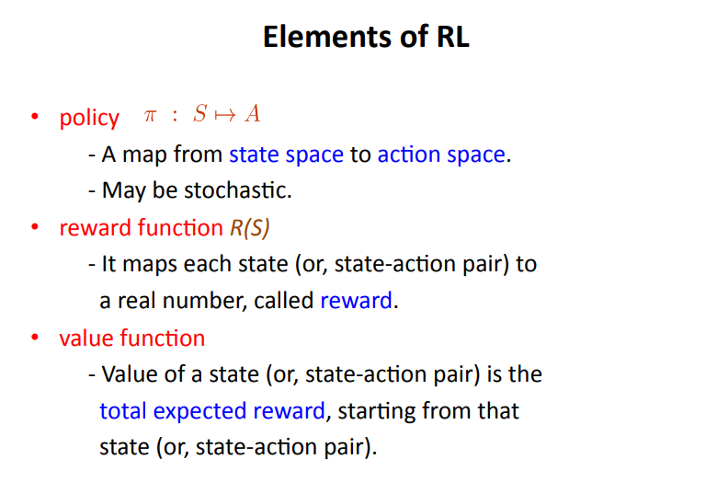

Slide 3
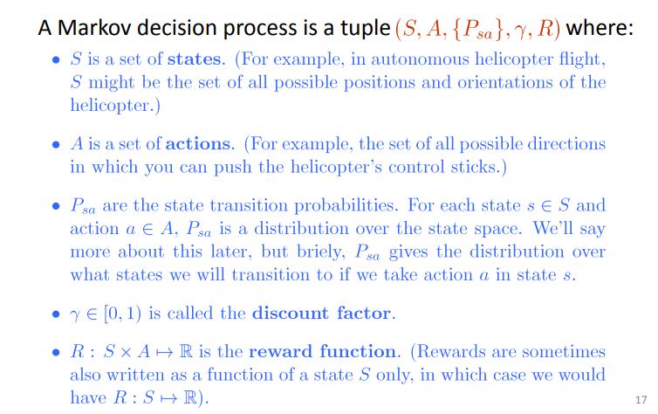

Slide 4
Markov Decision Process (MDP)
set of states S, set of actions A, initial state S₀
transition model P(s,a,s’)
P( [1,1], up, [1,2] ) = 0.8
reward function r(s)
r( [4,3] ) = +1
goal: maximize cumulative reward in the long run
policy: mapping from S to A
π(s) or π(s,a) (deterministic vs. stochastic)
reinforcement learning
transitions and rewards usually not available
how to change the policy based on experience
how to explore the environment
environment
reward
new state
action
agent

Slide 5
Markov Assumption
Markov Assumption: Transition probabilities (and rewards) from any given state depend only on the state and not on previous history
Where you end up after action depends only on current state
Transitions in state (1,2) do not depend on prior state (1,1) or (1,2)

Slide 6
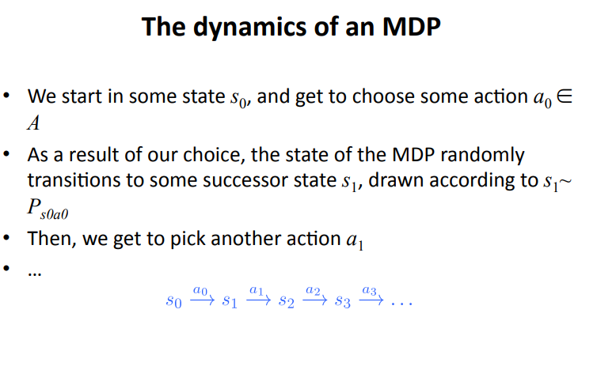

Slide 7
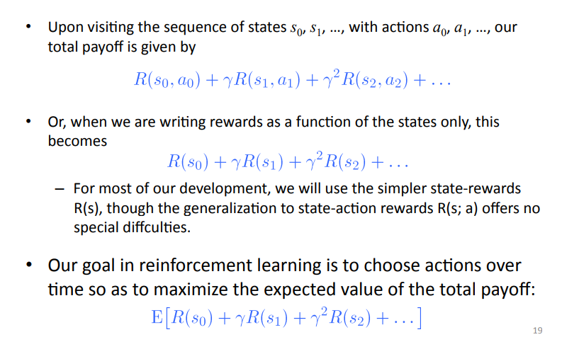
γ is the discount factor

Slide 8
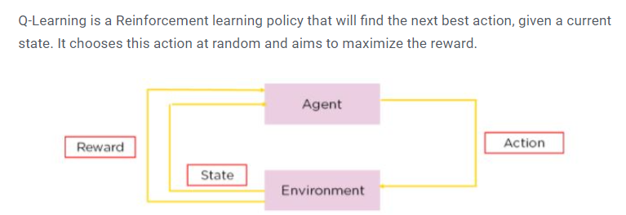
Sequential Decision Problems – Q Learning
Decisions are made in stages
The outcome of each decision is not fully predictable but can be observed before the next decision is made
The objective is to maximize a numerical measure of total reward to minimize a measure of total cost
Markov Assumption: Value of state is independent of path taken to reach that state. Can have memory of the past. Uses utility actions for each action.
Q-learning enables a agent to iteratively learn and improve over time by taking the correct action. Uses Q-values for each action
Solved Numerical: https://youtu.be/J3qX50yyiU0?si=FDoMOPWqQCwejmxa

Slide 9
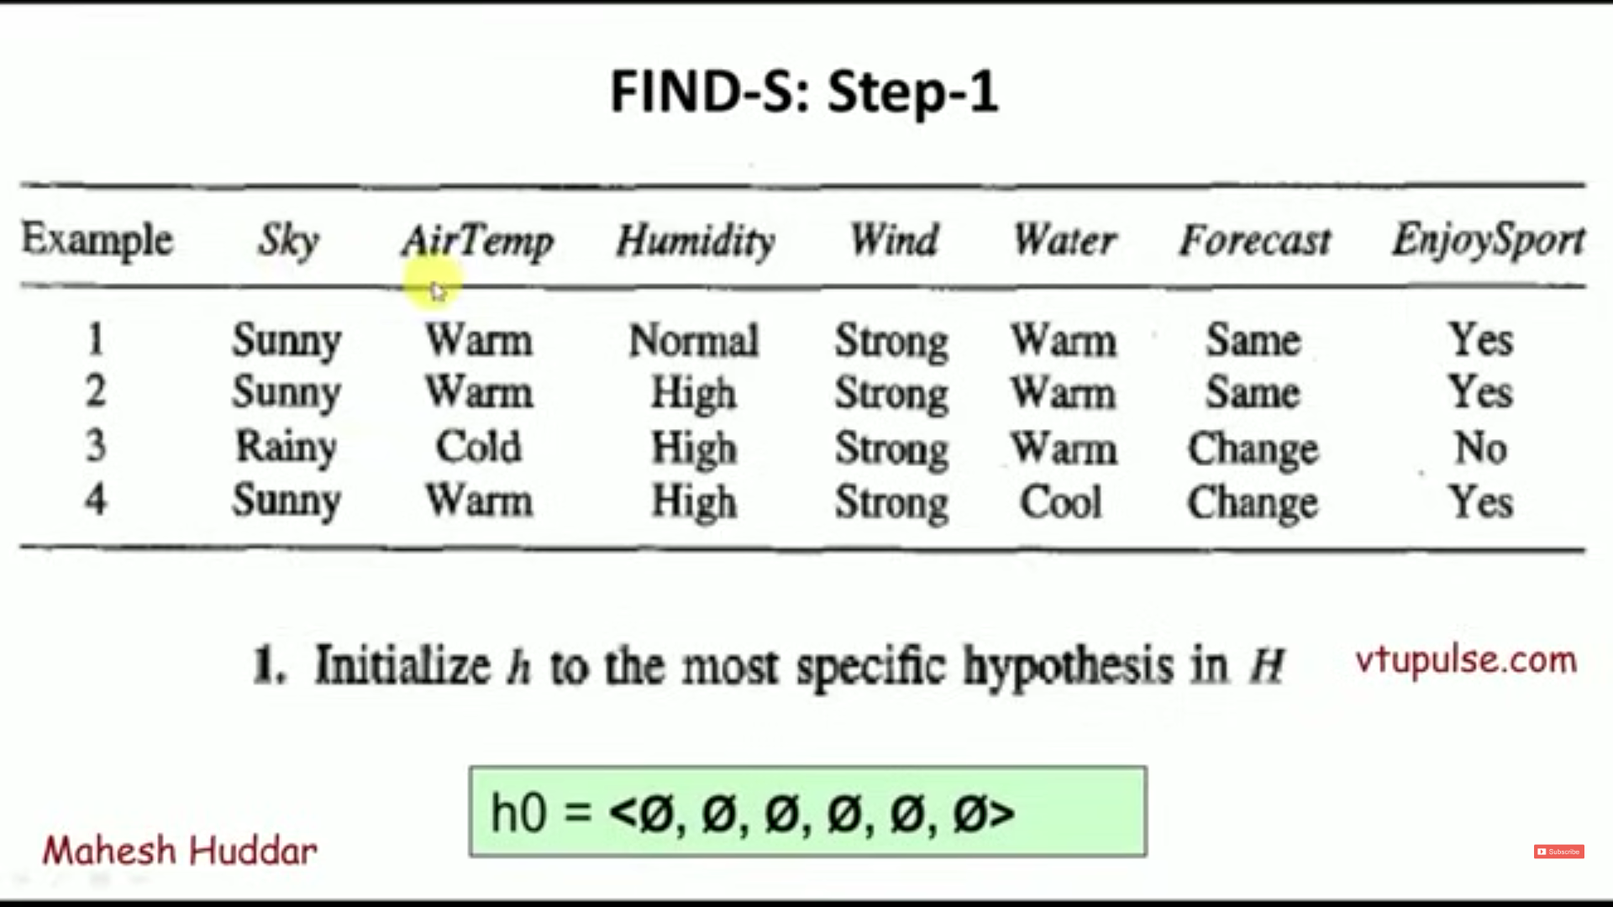
https://youtu.be/O6vwN74aSGY?si=u2JztYooCReKfIWV

Slide 10
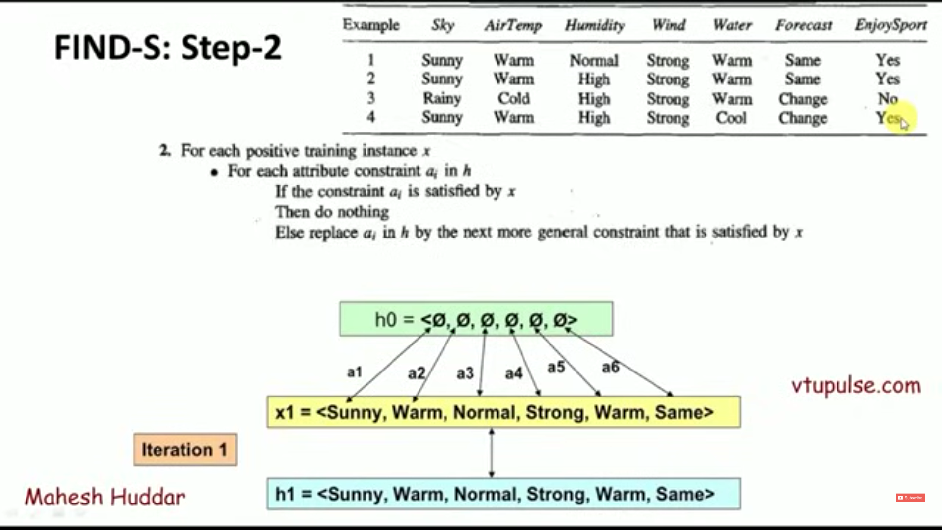

Slide 11
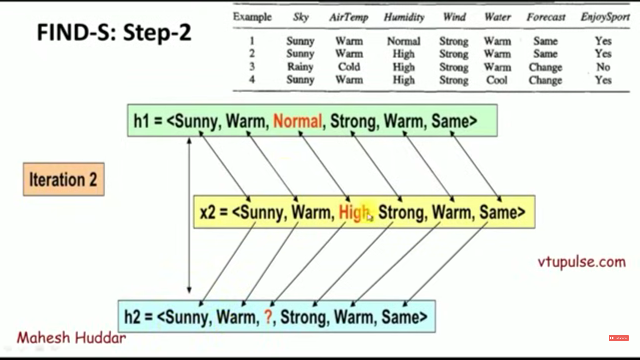

Slide 12
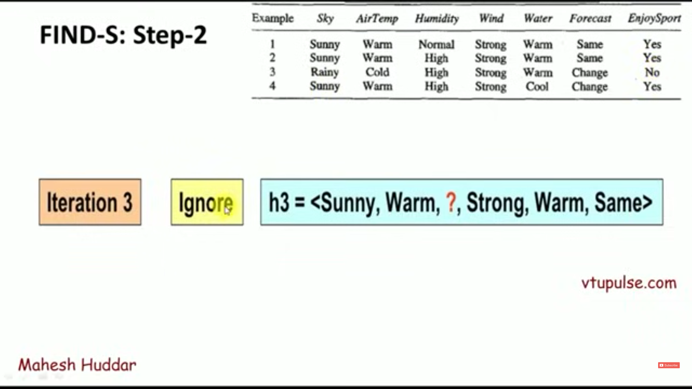

Only consider rows where Class label= +ve (Yes/True)

Slide 13
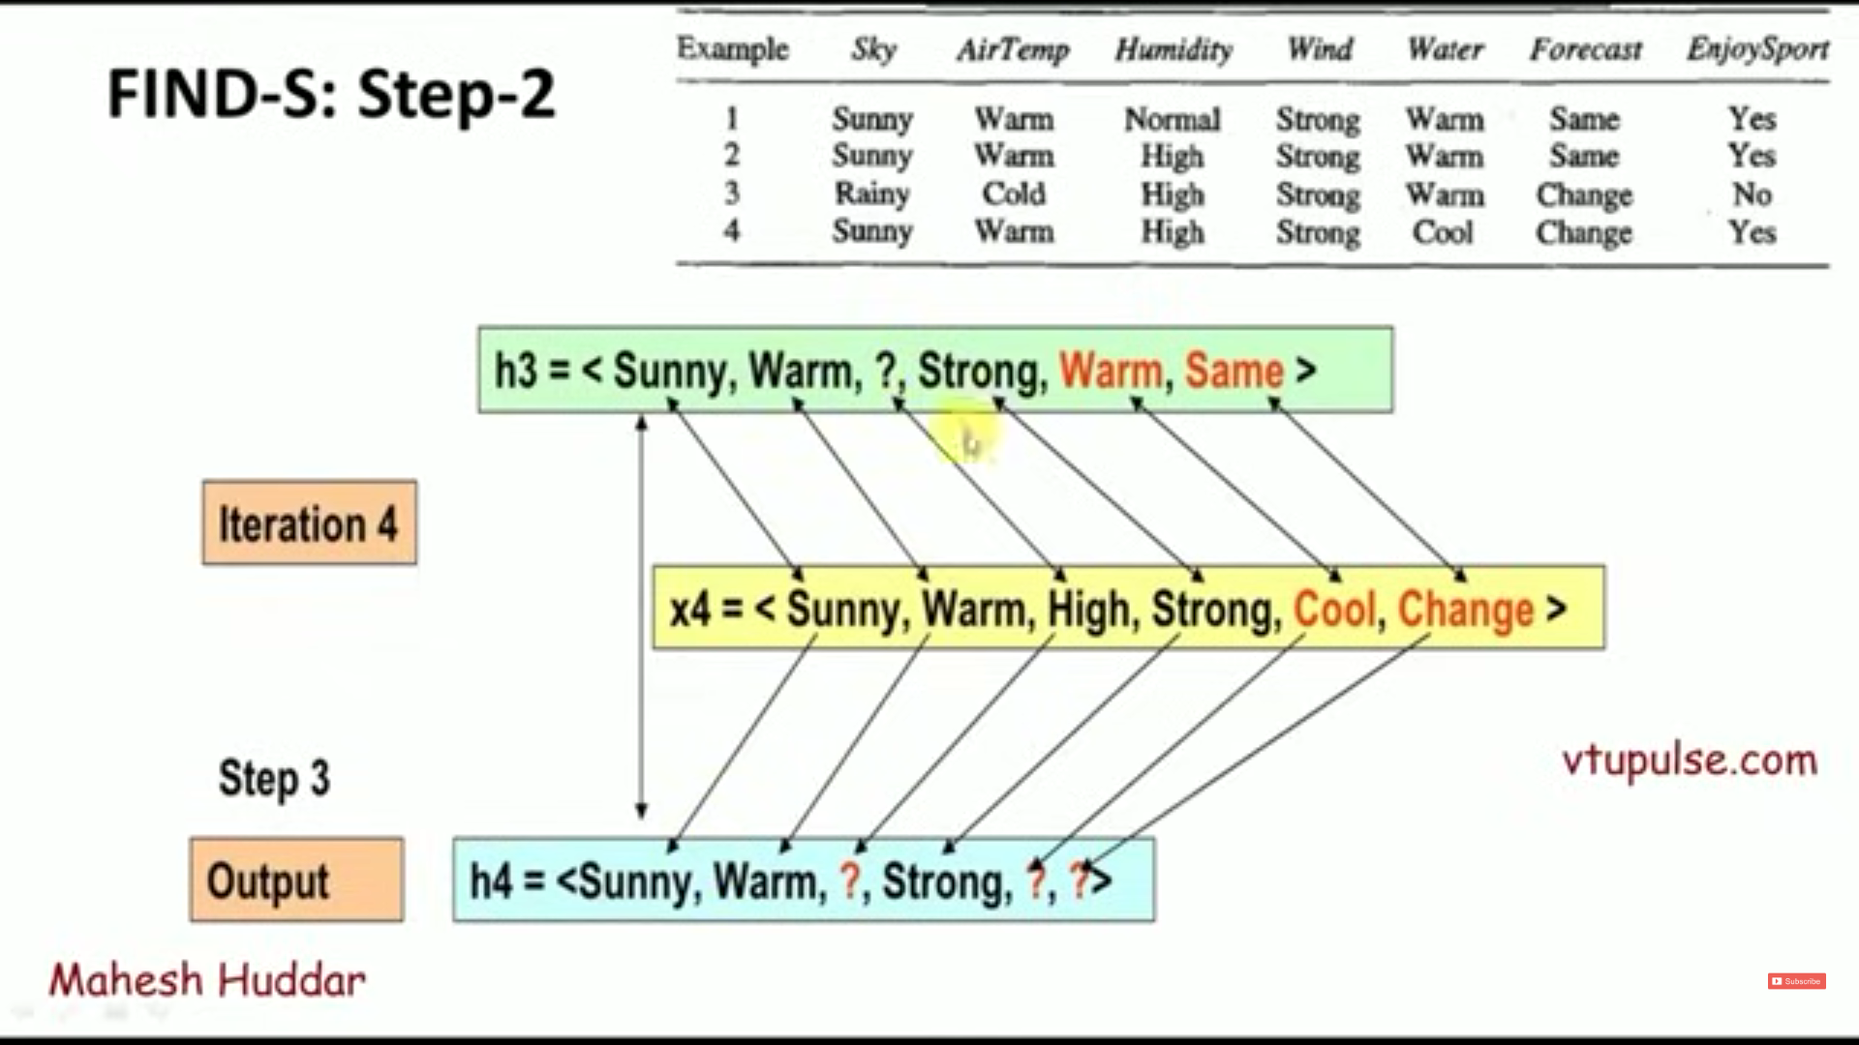

Slide 14
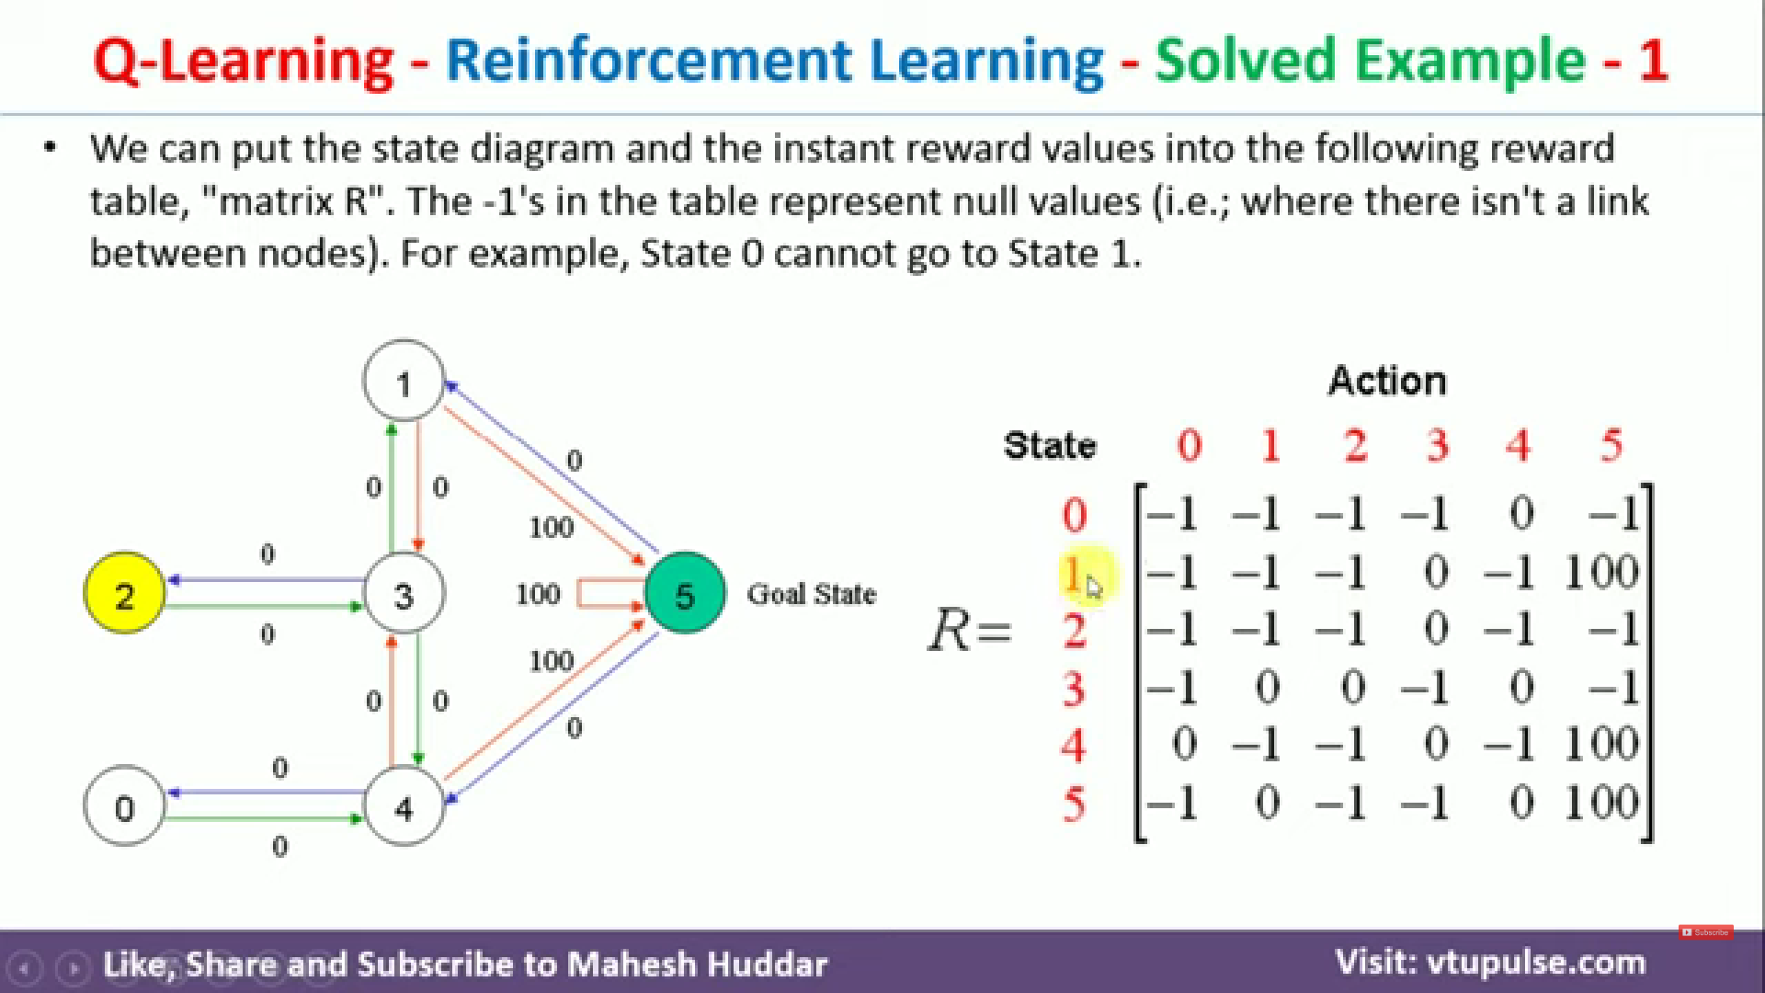

Slide 15
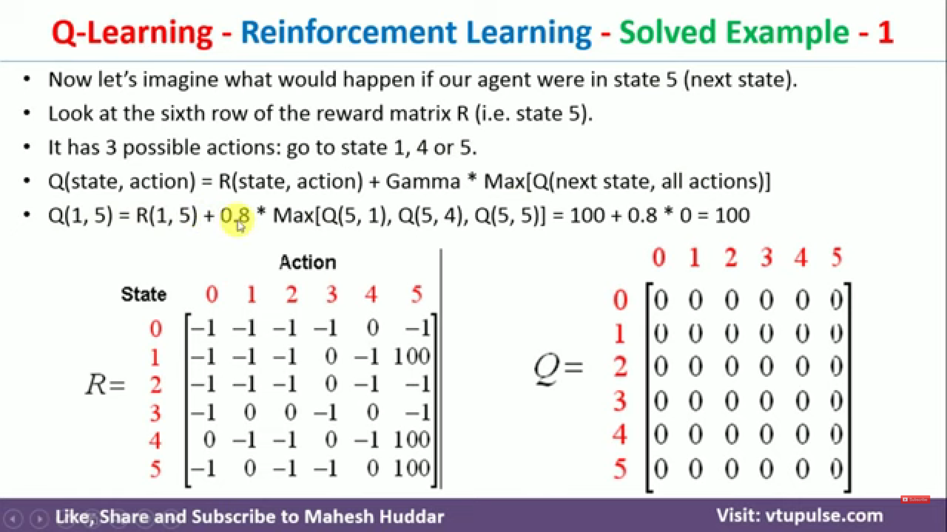

Slide 16
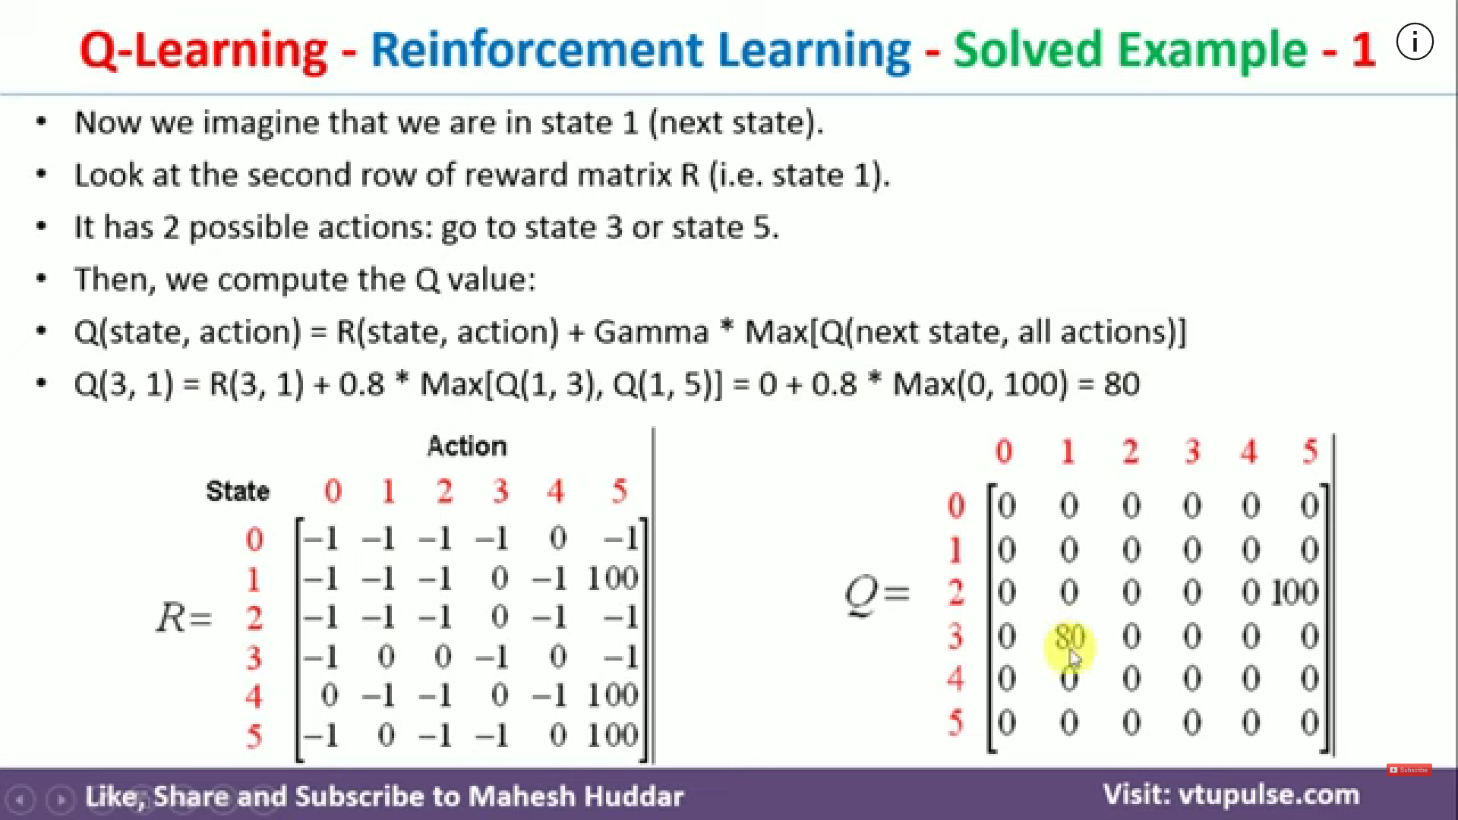
https://youtu.be/J3qX50yyiU0?si=jQXw7v2Au1oaHOaV

Slide 17
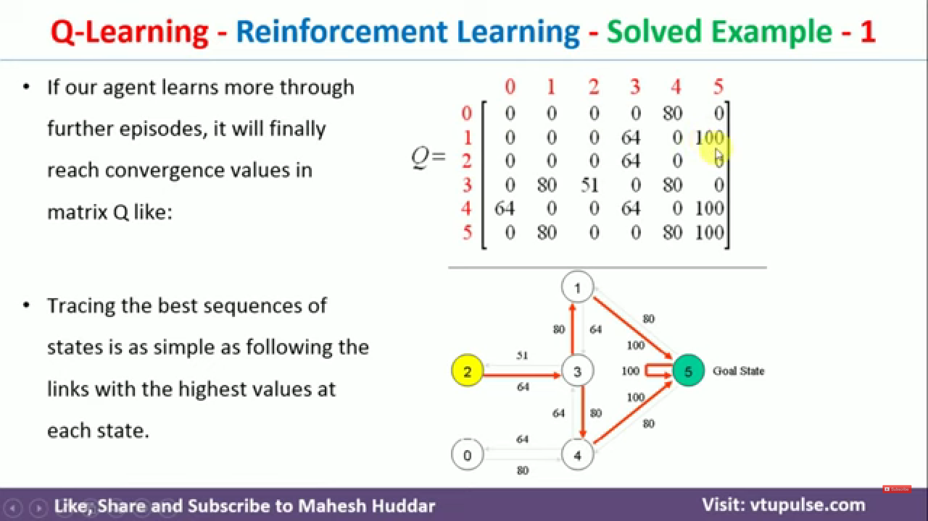

Slide 18
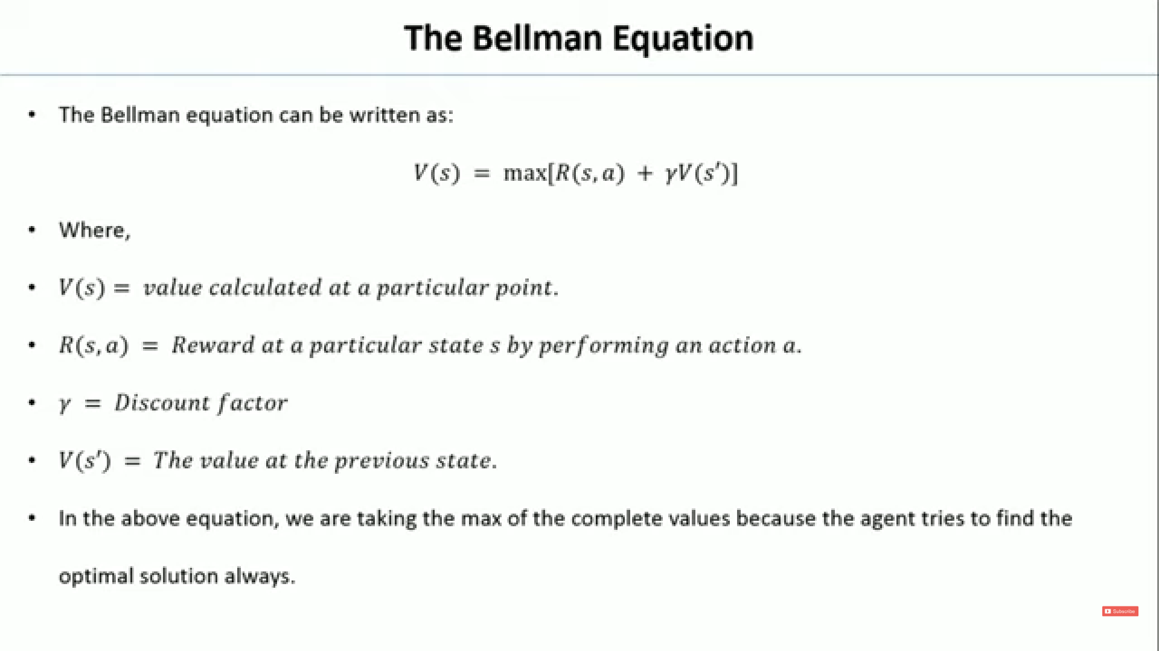

Slide 19
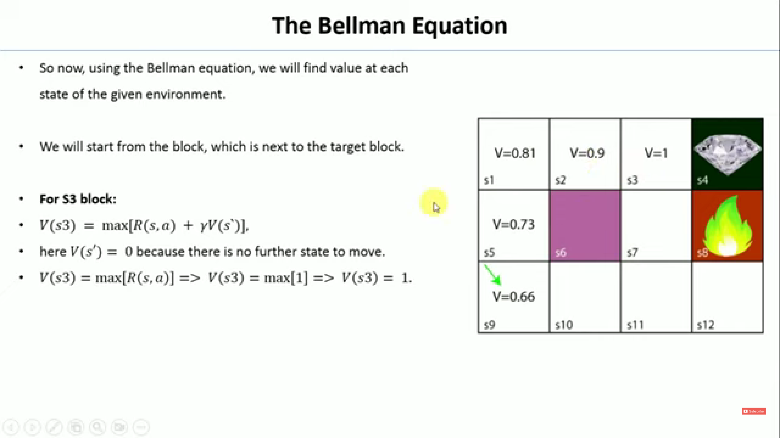
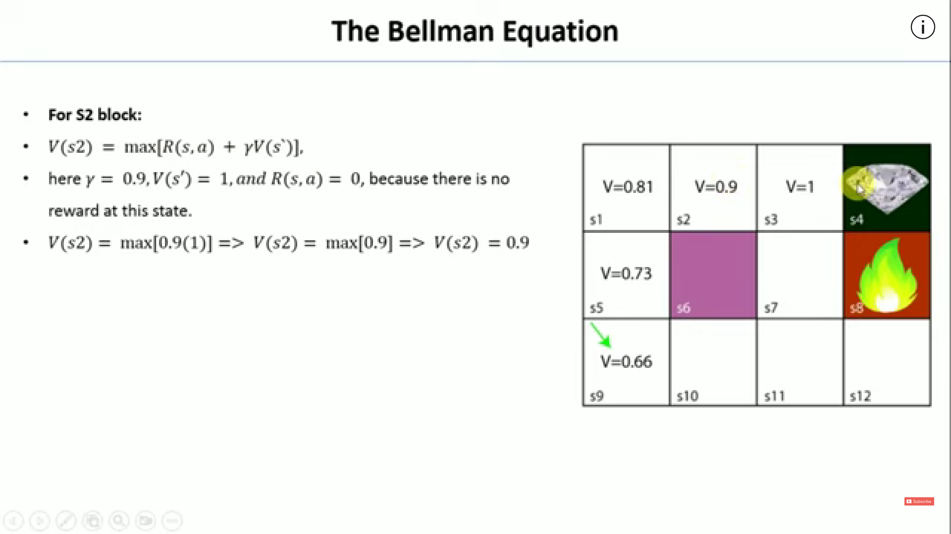
https://youtu.be/3Rx2x2traxw?si=y9LKgza5iDTc4JEw

